Slide 1

Innovation Drive and Technology Expo
Chris Ciolek
Nicholas Spencer
Maxx Achtman
Apolonio Cazares

Slide 2
Scope of the project (List)
Have a homepage to show Registration end dates for Technology and Attendee
Information tab for Event Info, Event Map, Contact Info, and Display Layout
Have an admin exclusive page only visible after an admin sign in
Build database for Technologies
Build database for Attendees
Scan QR codes to check in attendees on event days
Register Technology
Register for Attendance
Export Technology and or Attendee database to excel document
Send emails to Attendees (can be sent as blast or individual)
Badge Printing

Slide 3
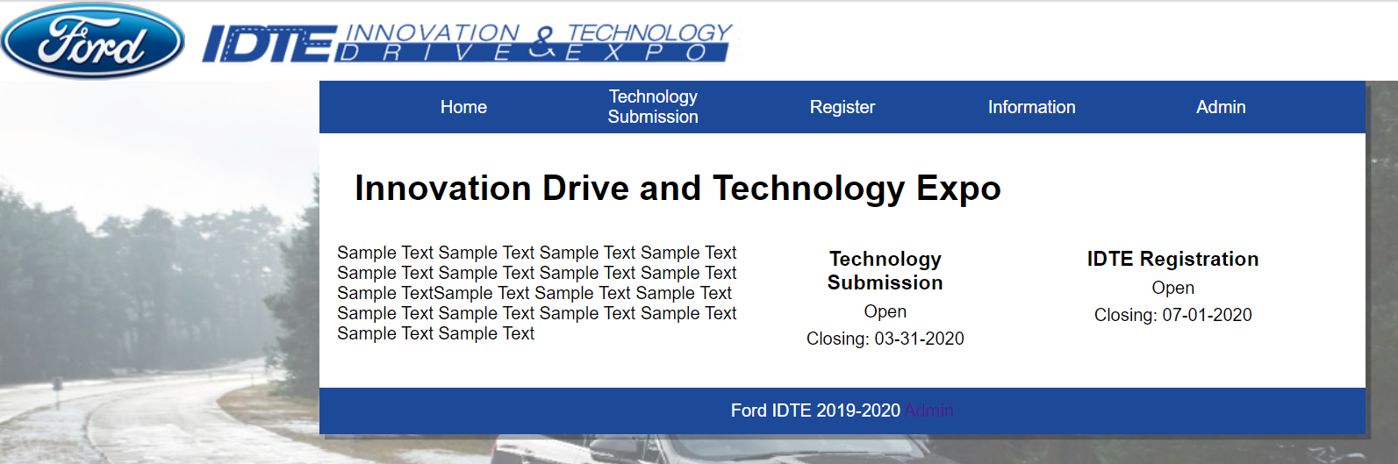
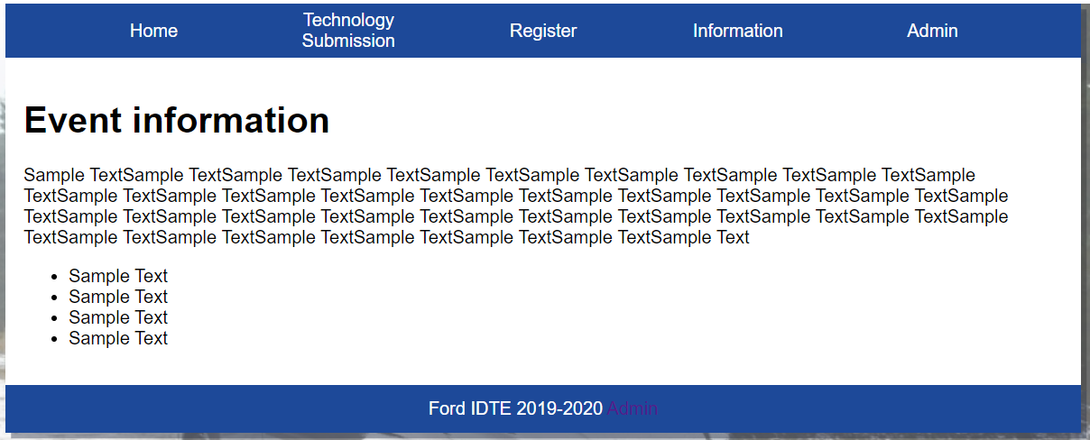
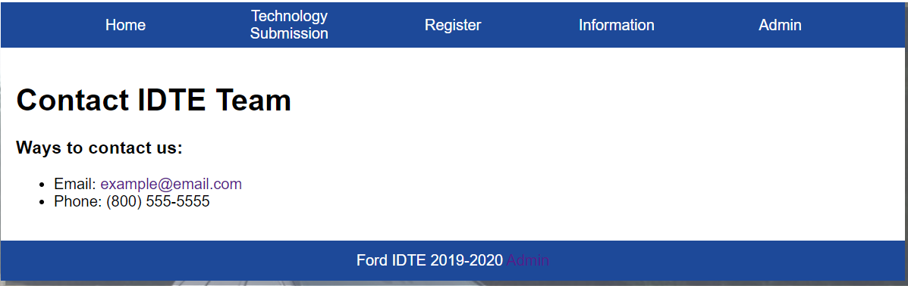
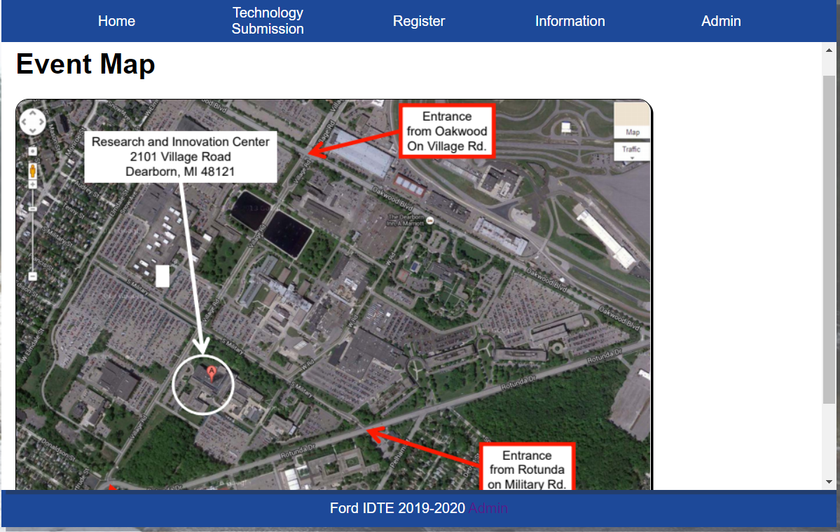
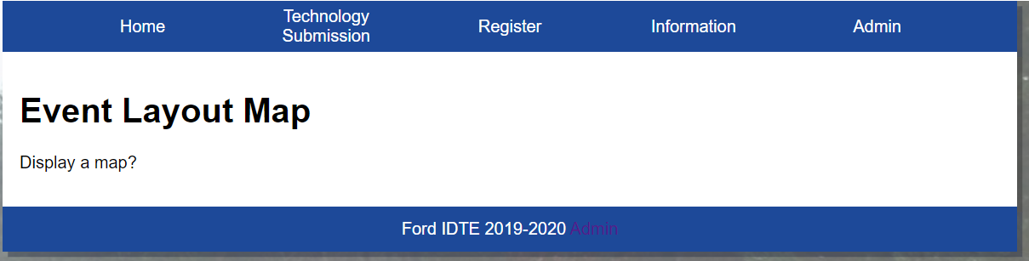
Homepage and information pages
Homepage
Event Information
Event Map
Event Layout Map
Contact Page

Slide 4
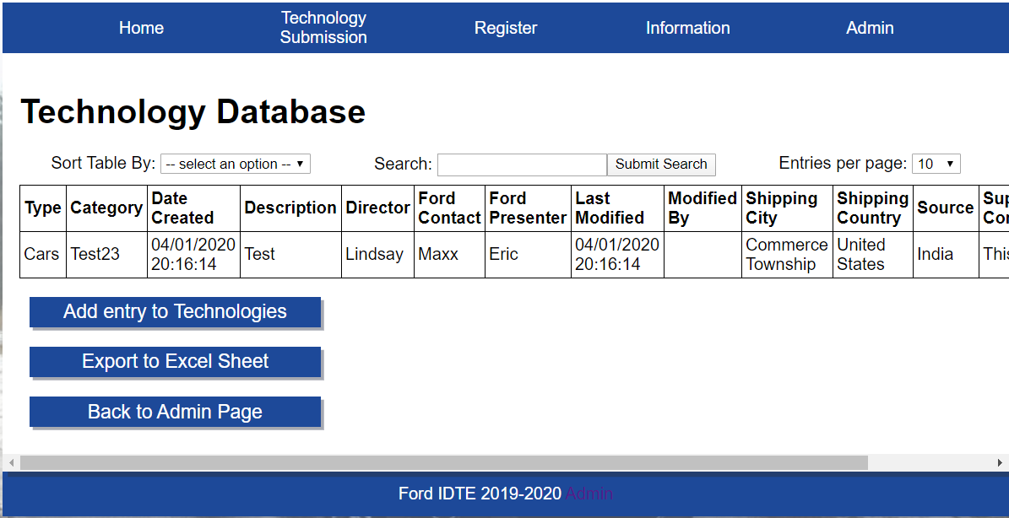
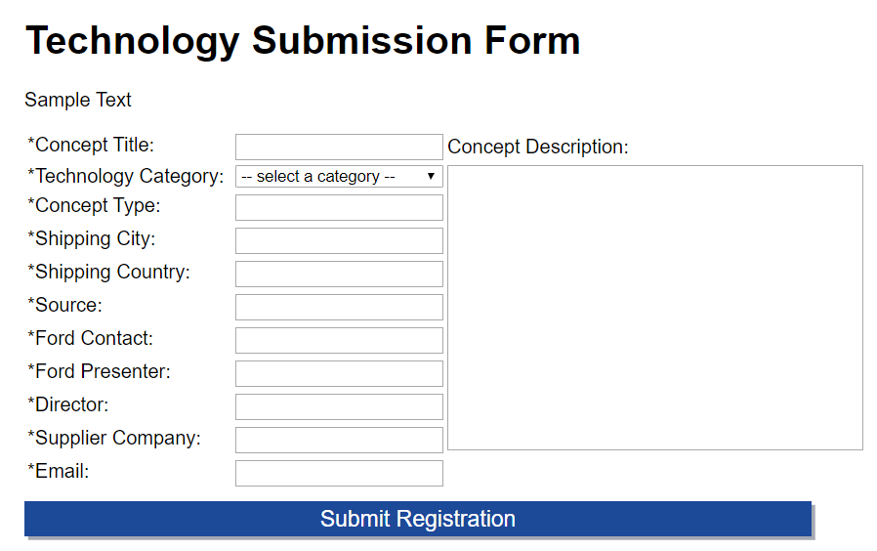
Technology Database and Registration
Technology Database
Technology Registration

Slide 5
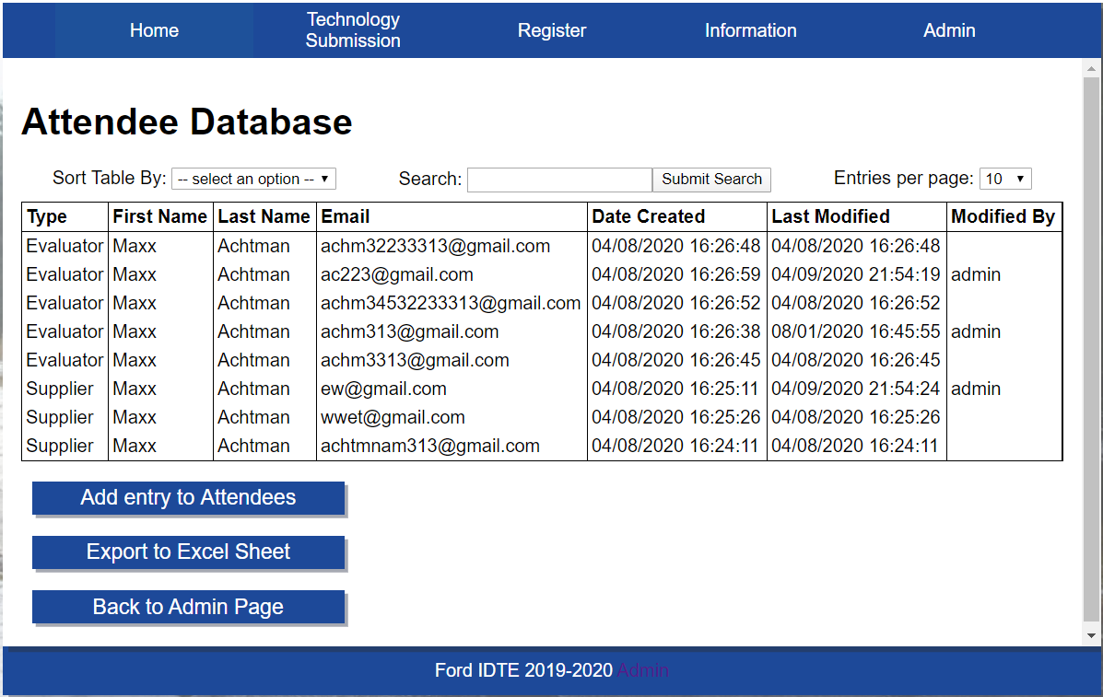
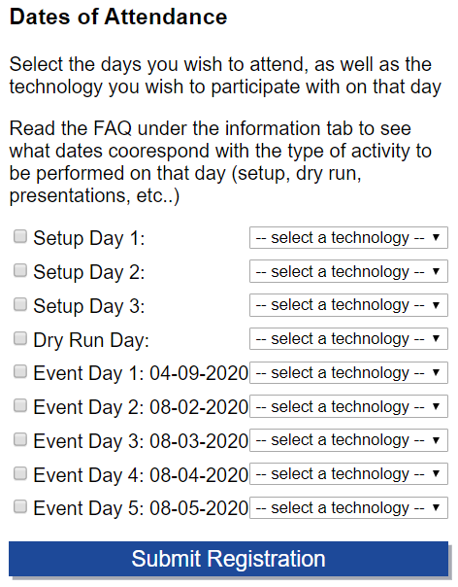
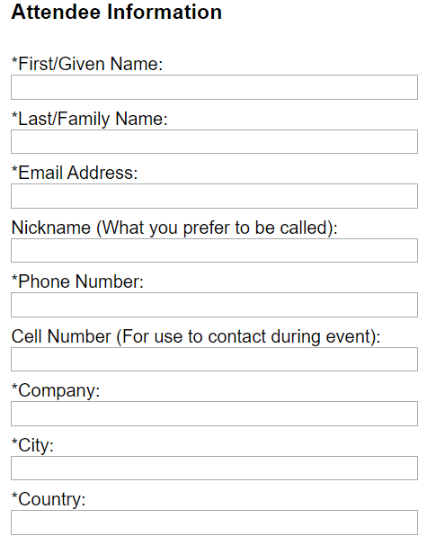
Attendee Database and Registration
Attendee Database
Attendee Registration

Slide 6
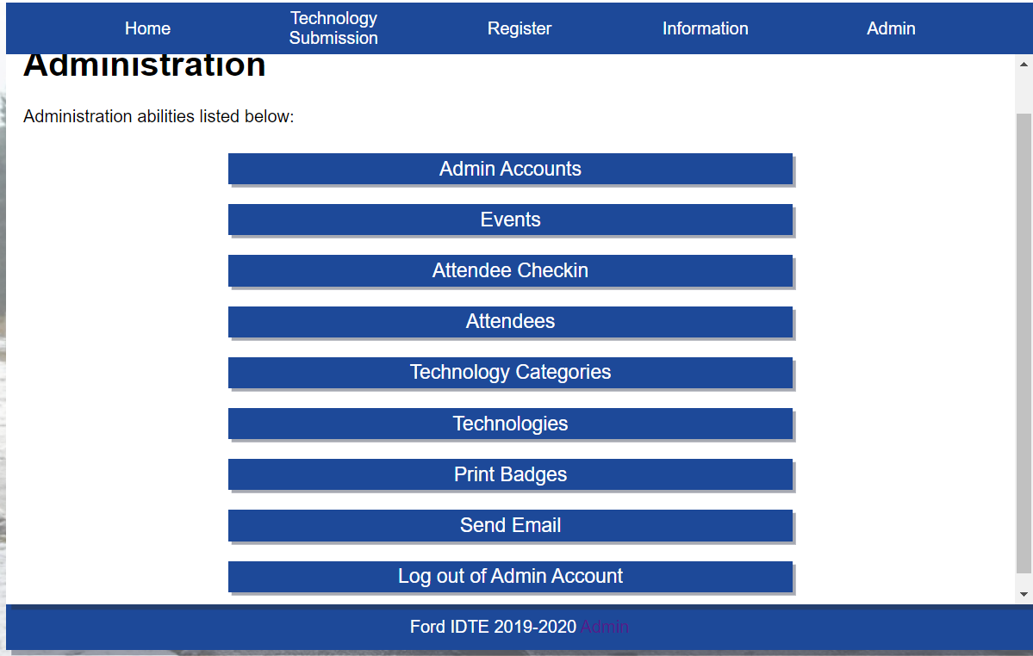
Admin Page

Slide 7
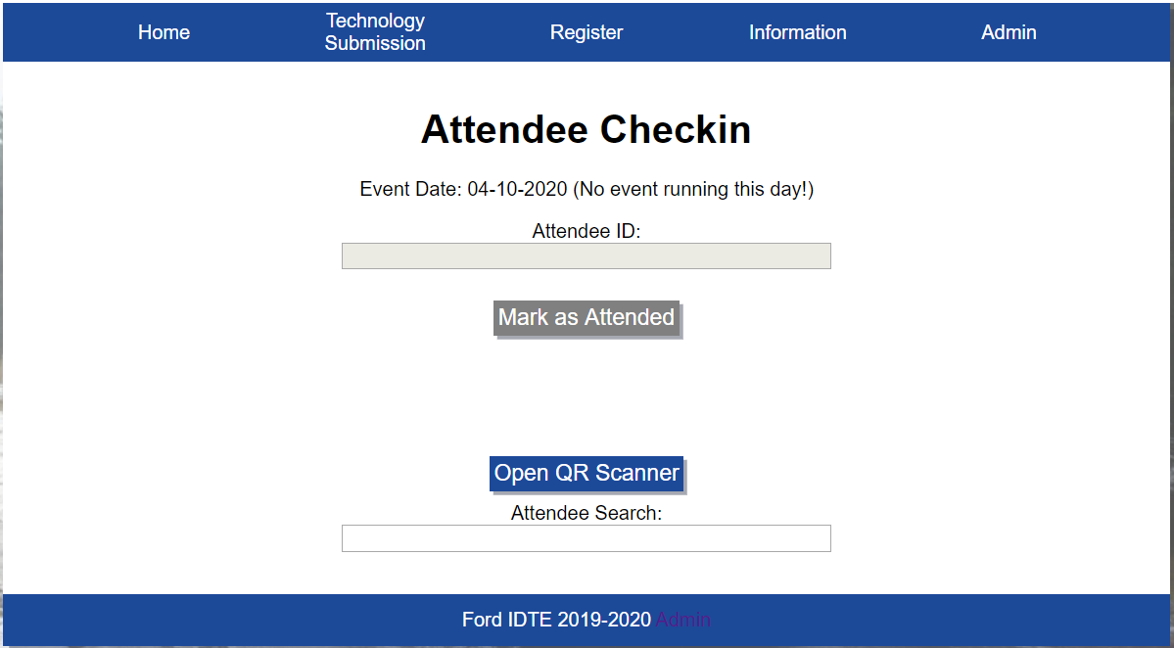
Scan QR Code Page

Slide 8
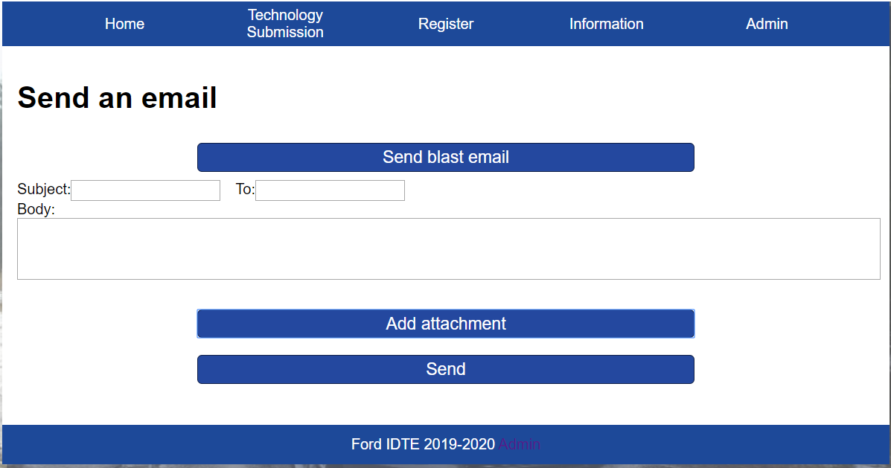
Send an email

Slide 9
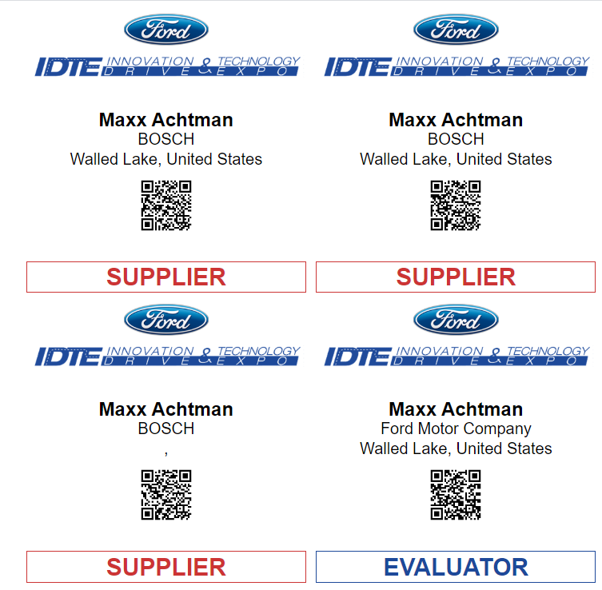
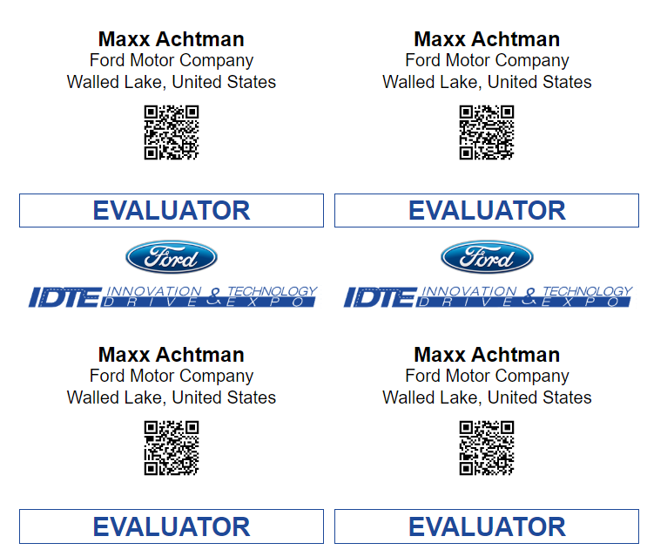
Print Badges

Slide 10

Why this project?
Ford hosts their Innovation Drive and Technology Expo every year. Building an online registration system would not only make it easier for attendees who wish to register a technology for viewing and show up to view others ideas, this website can allow the administration to know the following: who will be in attendance, what technologies are to be shown on a given day, and keep track of behind the scenes for their personal records

Slide 11
What went right?
All large requested features have been implemented into the website. Most smaller features have also been implemented.
Communication with the client was generally really good throughout the project, with weekly meetings for most of the project, moving to two meetings a week as the deadline drew near.
Team members stepped up during crunch time to ensure a successful project completion

Slide 12
What went wrong?
While the communication with the client was good, the communication with Ford’s IT team was not.
It was very difficult to figure out what technologies we should use to build the app, and hard to figure out what we needed to do in order to deploy the app to their servers.
At the end of the day, due to these issues, deployment is not something we will be able to do ourselves.
Progress was also generally slow until the last few months of development.

Slide 13
Lessons Learned
Establish better communication with the system administrators of the system you will be deploying to
Set more strict progress requirements to make sure that work is getting done
Diving headfirst into unfamiliar technologies can make early development slow and difficult
Use a different team structure that will fit the bill for the kind of project
If questions are needed by the client, ask sooner than later
Ask for client input during every meeting

Slide 14
How skills from major helped
Database creation and management (CIS 421)
Web development and interface design (CIS 435)
Web-Server architecture and design (CIS 427/435)
General coding and design skills from various courses
Documentation write ups (CIS 375/376)

Slide 15
Post Graduation Plans
Nick Spencer: Ford FCG
Maxx Achtman: Bosch PM
Chris Ciolek: Grad. school or internship
Apolonio Cazares: Find a job/internship

